Slide 1
References

Slide 2








Abbreviations
AEO = Annual Energy Outlook
b = barrel(s)
BEV = battery-electric vehicle
b/d = barrels per day
bkWh = billion kilowatthours
Btu = British thermal unit(s)
CFL = compact fluorescent lamp
CHP = combined heat and power
CO2 = carbon dioxide
CPP = Clean Power Plan
EIA = U.S. Energy Information Administration
gal = gallon(s)
GDP = gross domestic product
GW = gigawatt(s)
HGL = hydrocarbon gas liquids
ITC = investment tax credit
kWh = kilowatthour(s)
LED = light-emitting diode
LNG = liquefied natural gas
MARPOL = marine pollution, the International Convention for the Prevention of Pollution from Ships
MMBtu = million British thermal units
MMst = million short tons
NEMS = National Energy Modeling System
NGPL = natural gas plant liquids
OPEC = Organization of the Petroleum Exporting Countries
PHEV = plug-in hybrid-electric vehicle
PTC = production tax credit
PV = photovoltaic
Tcf = trillion cubic feet
ZEV = zero-emission vehicle

Slide 3
Graph sources
Projected values are sourced from
  Projections: EIA, AEO2020 National Energy Modeling System (runs: ref2020.d112119a, highprice.d112619a, lowprice.d112619a, highmacro.d112619a, lowmacro.d112619a, highogs.d112619a, lowogs.d112619a, hirencst.d1126a, lorencst.1201a)
EIA historical data are sourced from
  Monthly Energy Review (and supporting databases), September 2019
  Form EIA-860M, Preliminary Monthly Electric Generator Inventory, July 2019
For source information for specific graphs published in this document, contact annualenergyoutlook@eia.gov.

Slide 4
Contacts
AEO Working Groups
https://www.eia.gov/outlooks/aeo/workinggroup/
AEO Analysis and Forecasting Experts
https://www.eia.gov/about/contact/forecasting.php#longterm

Slide 5
AEO2020 Contact Information
Topic | Subject matter expert contact information
General questions | annualenergyoutlook@eia.gov
Carbon dioxide emissions | Perry Lindstrom | Perry.Lindstrom@eia.gov
Coal supply and prices | David Fritsch | David.Fritsch@eia.gov
Commercial demand | Meera Fickling | Meera.Fickling@eia.gov
Economic activity | Nicholas Chase | Nicholas.Chase@eia.gov
Electricity Generation | Laura Martin | Laura.Martin@eia.gov
Electricity prices | Lori Anti | Lori.Aniti@eia.gov
Ethanol and biodiesel | Steve Hanson | Steven.Hanson@eia.gov
Industrial demand | Peter Gross | Peter.Gross@eia.gov
National Energy Modeling System | Jennifer Palguta | Jennifer.Palguta@eia.gov
Natural gas markets | Katie Dyl | Kathryn.Dyl@eia.gov
Nuclear energy | Michael Scott | Michael.Scott@eia.gov
Oil and natural gas production | Meg Coleman | Meg.Coleman@eia.gov
Oil refining and markets | James Preciado | James.Preciado@eia.gov
Renewable energy | Chris Namovicz | Chris.Namovicz@eia.gov
Residential demand | Kevin Jarzomski | Kevin.Jarzomski@eia.gov
Transportation demand | John Maples | John.Maples@eia.gov
World oil prices | John Staub | John.Staub@eia.gov

Slide 6

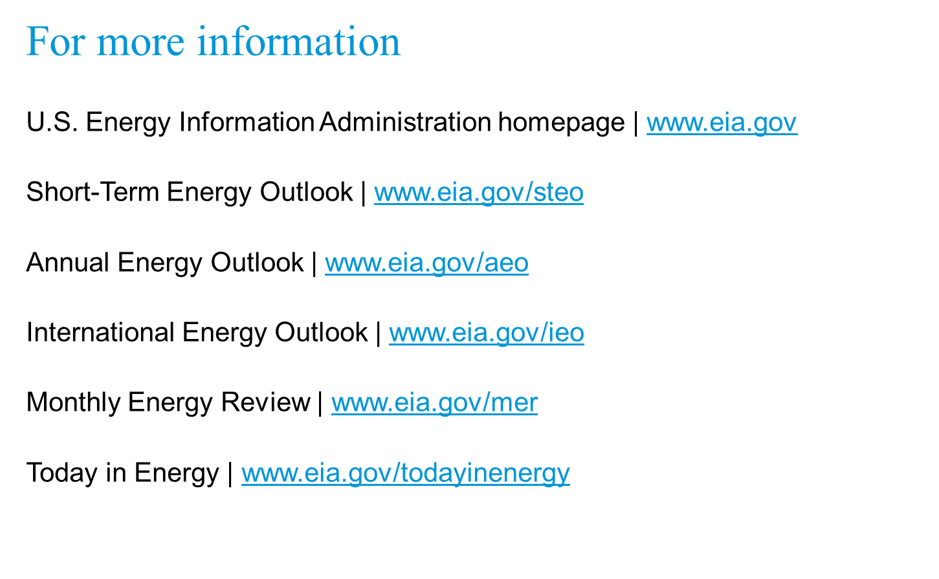

January 29, 2020
www.eia.gov/aeo
#AEO2020

